Slide 1
Schooling policies for quality and economic growth
Eric A. Hanushek
Stanford University
May 2013

Slide 2
Key Questions
1. Does achievement matter?
YES
2. Is Spain competitive?
NO
3. How is Spain doing?
NOT WELL
4. Are there things to be done?
YES

Slide 3
Does achievement matter? and
Is Spain competitive?

Slide 4
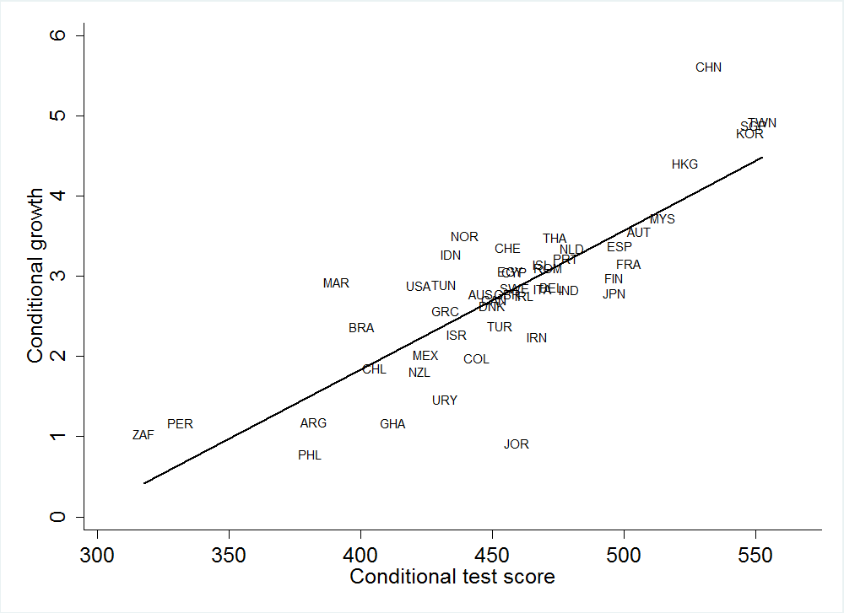
Cognitive Skills and Long Run Economic Growth

Slide 5
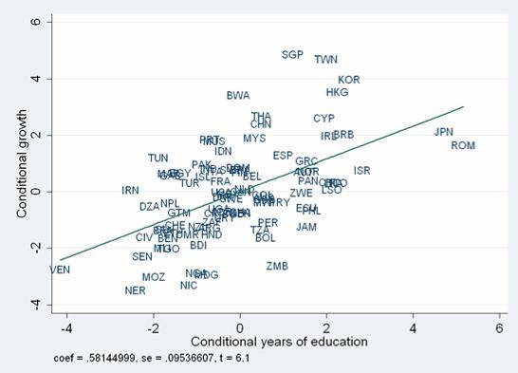
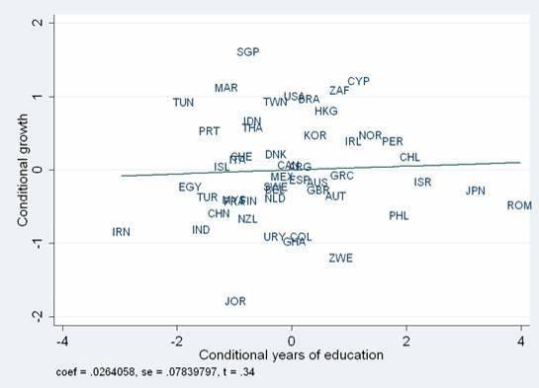
Years of Schooling and Economic Growth
With quality control
Without quality control

Slide 6
PISA Mathematics Achievement, 2009

Slide 7
PISA Mathematics Achievement, 2009

Slide 8
PISA Mathematics Achievement, 2009

Slide 9
Present Value of Gains to GDP for Spain

Slide 10
Present Value of Gains to GDP for Spain

Slide 11
How is Spain doing?

Slide 12
Achievement Growth, 1995-2009
Notes:
Drops 7 negative including France and Norway

Slide 13
Are there things to be done?

Slide 14
Resource Policies
Little evidence of success
  Cross country evidence
  Within country – developed
  Within country – developing

Slide 15
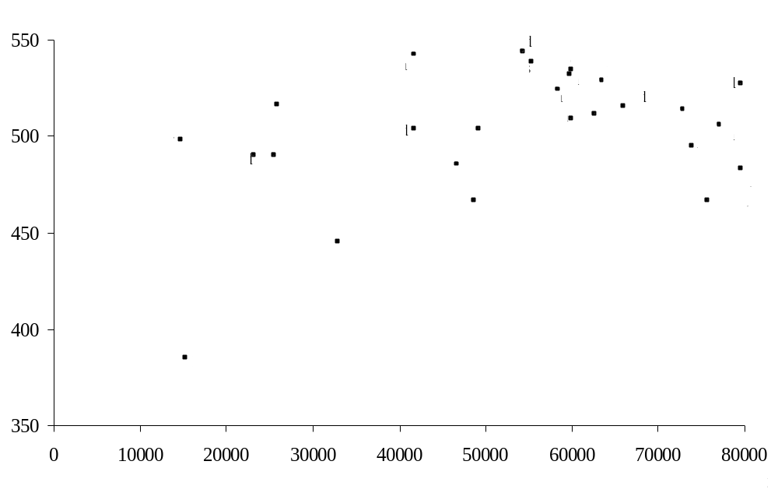
Resources and Performance across Countries
R ² = 0.01
R ² = 0.15
Notes:
Pro tracking:
Teachers do not have to worry about boring the fastest learners or losing the slowest learners
Contra tracking (pro ungrouped classrooms):
Concern: lower groups will be systematically disadvantaged by slower learning environments
If preparation on entry into school related to socio-economic background → continuing bias against more disadvantaged students

Slide 16
Resource Policies
Little evidence of successle evidence of success
  Cross country evidence
  Within country – developed
  Within country – developing
Consistent with detailed analysis
  class size
  school characteristics

Slide 17
Resource Policies
Does not say “resources never have effect”
Does not say “resources cannot have effect”
  No expectation within current incentive structure

Slide 18
Teacher Quality
Teachers most important input
No identifiable characteristics
  Master’s degrees
  Experience*
  Certification
  Preparation
  Professional development
Observable through both student performance and supervisor ratings
Cannot regulate and pay on characteristics

Slide 19
Institutional Reforms Supported by Evidence
Centralized exams
Accountability
Autonomy/decentralization

Slide 20
Institutional Reforms Supported by Evidence
Centralized exams
Accountability
Autonomy/decentralization
Choice
Direct performance incentives

Slide 21
Alternative Estimates of Least Effective Teachers
(United States distribution)
Notes:
Deselect teachers at bottom
mean of truncated distribution = density/cum at cutoff calculate for N(0,1) and then translate into student achievement distribution
13 years times change in mean
Canada approx +0.5 sd; Finland +0.75 sd

Slide 22
Alternative Estimates of Least Effective Teachers
(United States distribution)
Notes:
Deselect teachers at bottom
mean of truncated distribution = density/cum at cutoff calculate for N(0,1) and then translate into student achievement distribution
13 years times change in mean
Canada approx +0.5 sd; Finland +0.75 sd

Slide 23
Alternative Estimates of Least Effective Teachers
(United States distribution)
Notes:
Deselect teachers at bottom
mean of truncated distribution = density/cum at cutoff calculate for N(0,1) and then translate into student achievement distribution
13 years times change in mean
Canada approx +0.5 sd; Finland +0.75 sd

Slide 24
Key Questions
1. Does achievement matter?
YES
2. Is Spain competitive?
NO
3. How is Spain doing?
NOT WELL
4. Are there things to be done?
YES

Slide 25
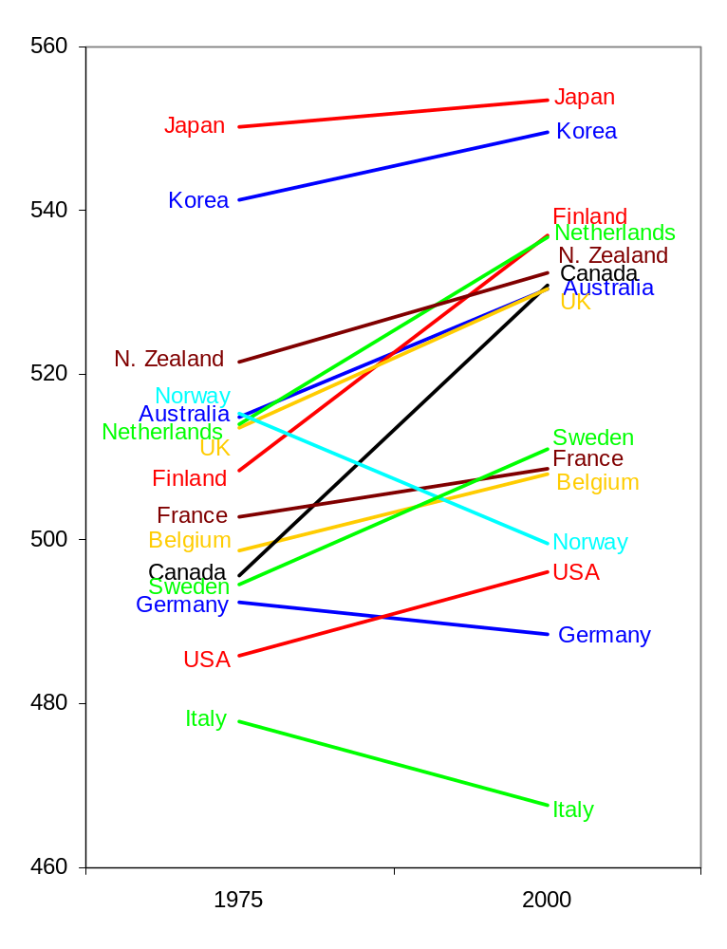
Trends in
Test Scores

Slide 26
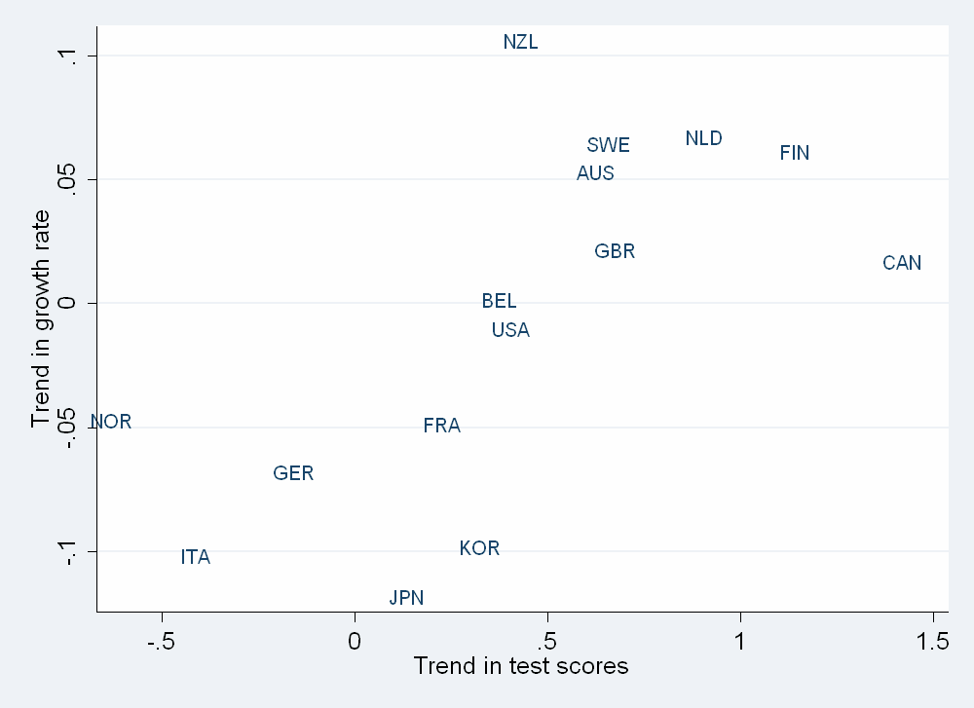
Changes in Growth Rates vs. Changes in Test Scores

