Slide 1

What threatens capitalism now?
Professor Craig Calhoun
Director and President
London School of Economics

Slide 2
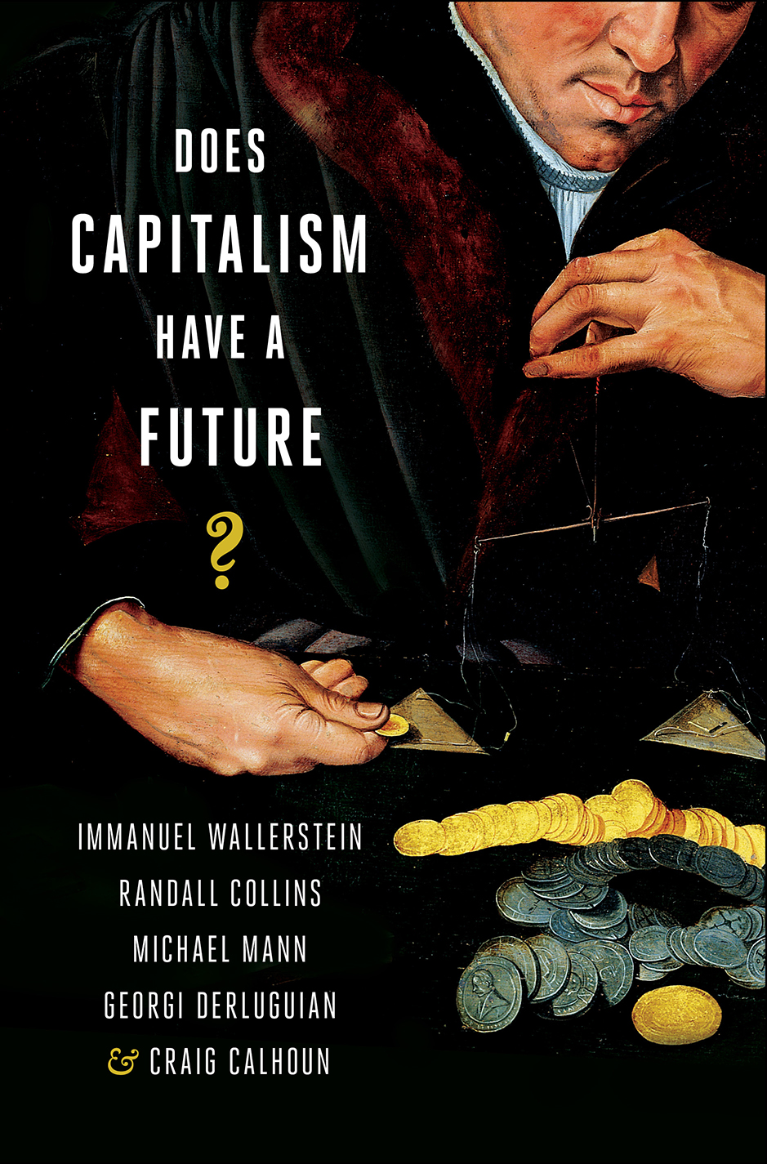

Slide 3
Collapse?
Capitalism seems to be surviving a deep and still lingering global crisis
  A longer period of depressed growth than the Great Depression
Predictions of its immanent collapse often highlight genuine weaknesses, but nonetheless are misleading
The USSR could “collapse” because it was a state.

Slide 4
Transformation
Capitalism is more likely to be transformed
  Possibly gaining new resilience
  Possibly changing beyond recognition
    State capitalism
    One system among many
The model is not collapse of a state, but more like feudalism giving way to capitalism itself over 300 years.
  and giving way not simply to capitalism,
  But to stronger monarchies, empire and nation-states
Moreover, capitalism is still growing in much of the world

Slide 5
Thinking from the crisis
Close to the precipice
Too connected to fail
Massive capital injections stopped the spiral.
But bailouts triggered fiscal crises.
Then fiscal crises triggered political, diplomatic, and social crises, especially in the Eurozone.
But lingering unemployment, lack of growth and widespread unhappiness have brought no systemic transformation

Slide 6
Systemic Risk
Capitalism in general and the ascendancy of finance
Dramatic increase in proportion of financial assets
  In US, from 25% in 1970s to 75% in 2008
Creative destruction and new technology
Asset price bubbles
Intensifications of interdependence
  “too connected to fail”?

Slide 7
Institutional deficits
Double movement (Polanyi)
  Dynamism
  Distribution
Inequality and social cohesion
Social contract
  The implicit bargain for growth
  Loss of legitimacy
States, civil society, and even firms

Slide 8
Scarce resources and degraded nature
  The need for growth and the limits to growth
    Land
  Energy
  Minerals
  Pollution
  Climate change
Financial non-solutions
  Cap and trade

Slide 9
Capitalism as an externalization regime
The production of wealth and the distribution of “illth”
Public goods
  Knowledge
  Environment
Migration
Informalization

Slide 10
Capitalism’s context
The return of geopolitics
  Faultlines of former empires
Illicit capitalism
Regions, religion and nation-states
  Cosmopolitanism and belonging
The world-system
  Decline of hegemony
  Chaos
  Multilateral leadership

Slide 11
Capitalism is unlikely to collapse next week, but it is also unlikely to last forever.
And if it lasts, it will be because it changes

